Slide 1
The Production of Health Lecture
Vinish Shrestha

Slide 2
Econ 339 - Roadmap
Focus Midterm 1
Focus Midterm 2
Focus Final
Review of Microeconomics
Demand for Insurance
Chapter 7
Uncertainty
Risk aversion
The health policy conundrum
Chapter 15
Capital stock K
Intro (from my slides)
Adverse selection
Chapters 8 and 9
Akerlof’s market for lemons
Rothschild-Stiglitz model
The Beveridge Model
Chapter 16
Production of Health (from my slides)
Demand for health care
Chapter 2
The American Model
Chapter 18 and slides provided (ACA)
Adverse Selection in
Real market
Chapter 10
The Grossman model
Chapter 3
Socioeconomic
Disparities
Chapter 4
Special Topics (if time allows)
Chapter 20
Slides provided
Moral hazard
Chapter 11

Slide 3
Things to learn
Some economic assumptions
Forward looking behavior
Why and how is health economics different?
Health production function
Demand for health services
Health behavior (derived demand)
Marginal Product of Health

Slide 4
Some Economic Assumptions
Rationality
Individuals use all relevant information available when weighing benefits and costs
For example, Decision to attend school (benefits & costs)
What are some costs
Forward Looking
Economists not only consider the present costs but also future ones
Example, $1 today is worth more than $1 benefit tomorrow (Time Value of Money)
The trade-off between today’s and tomorrow depends on individual’s time preference

Slide 5
Some Economic Assumptions
$1 tomorrow is worth $1/(1+r)
r = rate of individual’s time preference “discount rate”
Higher discount rate would mean that you do not value future so much
Time consistent
Apply the same discount rate throughout the life cycle

Slide 6
Health Economics as a different form of economics (Kenneth Arrow, 1963)
1. Uncertainty
Might know how many bananas you will purchase tomorrow, but it is uncertain as to consumption of medical services
2. High externalities
Contagious
Flu shots
3. Provision of insurance
Adverse selection
Moral hazard

Slide 7
Asymmetric Information
Gap in information between two parties
Say, buying a car in craigslist. Do they have same level of information?
Lemons will drive away the good cars from the market (George Akerlof 1970). Sellers have more information compared to consumers. Consumers do not want to pay high prices for uncertain car quality. Sellers would never want to sell good cars for low prices. Low prices that consumers want to pay drives good cars away from the market. Only lemons remain.
Always a gap between patient’s and doctor’s information
If a physician acts totally in favor a patient, a well-informed physician can make decision for the patient
Information asymmetry in health insurance market
Health insurance customers tend to know more about their health risks than the insurance companies
Whether a customer gets insurance can depend crucially in one’s health status, due to strong self interest of lying
Asymmetric information leads to adverse selection

Slide 8
Can a private insurance market for people >65 be sustainable?
People over 65 have higher risks (from an insurance company’s perspective)
Why doesn’t prices (premiums) rise to match such risk?
Variation in risk (some prone to illness, some not so). The people (potential insurance buyer) will know one’s level of risk.
There is a gap of information between buyer and insurance company (asymmetric information)
For higher prices charged by insurance companies, will drive out relatively healthy.
Then insurance company will have to increase prices more. Drive another batch of relatively healthy.
Adverse selection. Hence, Medicare.

Slide 9
Health Production
Production Function relationship between input and output
The idea is to treat health as an output
What creates a shift in health production function?
Health
f(health care, lifestyle, environment, genetics)
Health care

Slide 10
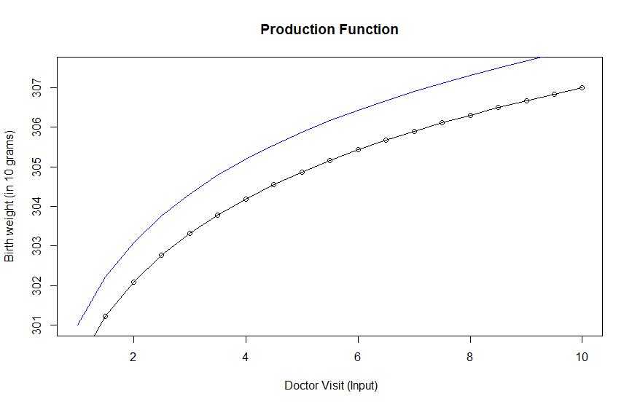

Slide 11
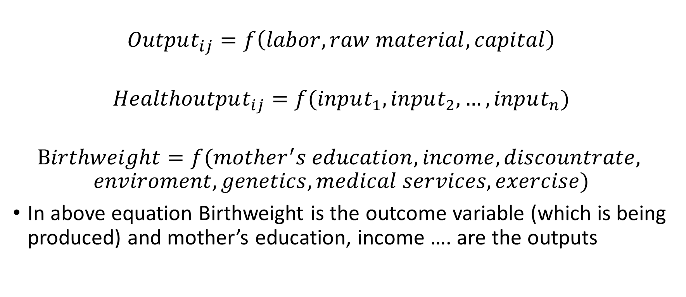
Health Production Function
$$Output_{ij}=f\left(labor, raw material, capital\right)$$
$$Healthoutput_{ij}=f(input_{1}, input_{2}, …, input_{n})$$
$$Birthweight=f(mother^{′}s education, income, discountrate,$$
$$enviroment, genetics, medical services, exercise)$$
In above equation Birthweight is the outcome variable (which is being produced) and mother’s education, income …. are the outputs

Slide 13
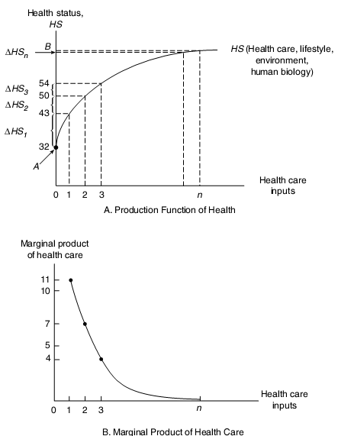
Diminishing Marginal Returns

Slide 14
Marginal Product of Health
Effect of every additional increase of health input (doctor visit) on health (birthweight)

Slide 15
How to measure health
Health as a latent concept, but can we measure health?
Some proxies
Number of healthy days
Health status
Life expectancy
Infant mortality
Biometric measures (Cholesterol level, BP, cotinine level)
What are some of the drawbacks of these measurements?

